Slide 1



BORING CLUB 5/7/2024
GENERAL MEETING

Slide 2

PREVIOUS MEETING RECAP
Joystick Control, Wireless Communication
01
Electrical Subteams
02
5/7/2024

Slide 3
AGENDA
TX & RX Team: Use Arduino Uno to communicate from transmitter to receiver (then move to nanos and servo)
01
02
Drive Control team: control the drive

Slide 4
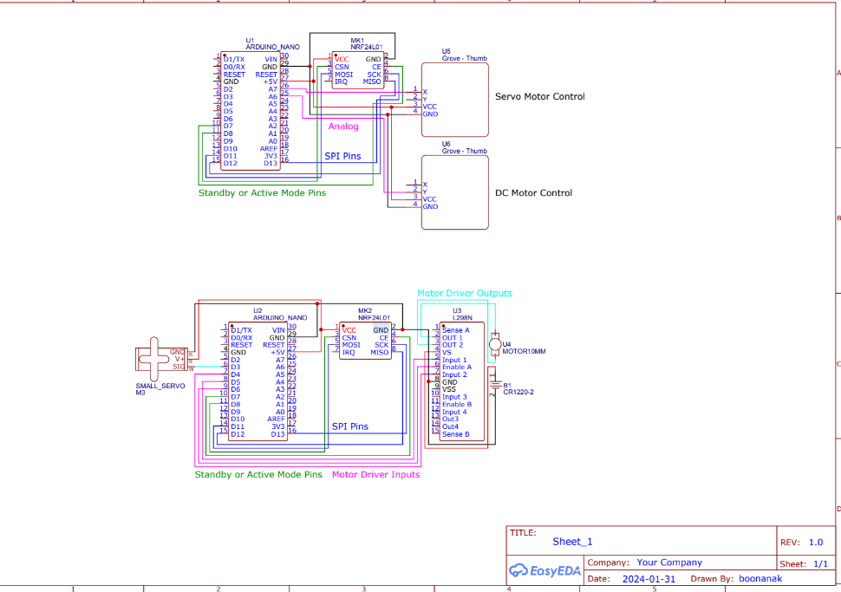
Schematic for Review
(See Repo for updated one)

Slide 5
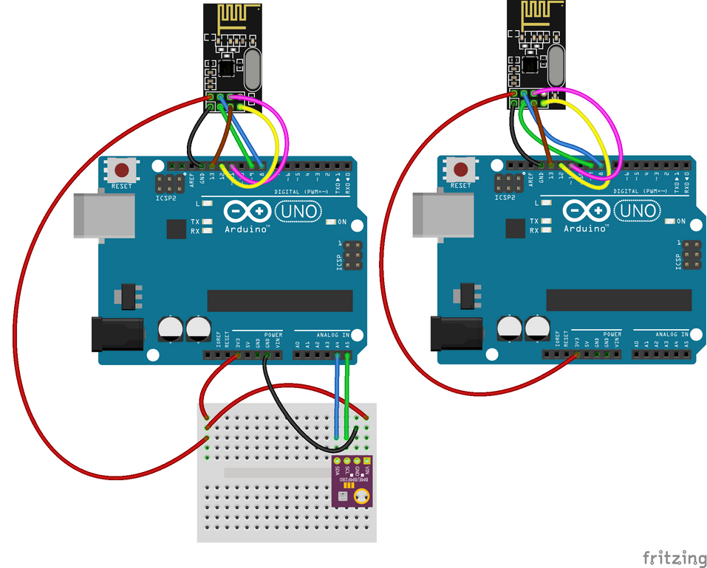
ARDUINO NANO COMMUNICATION
General Tips
Board is NOT a nano! It will actually come up as an Arduino Uno R3
Remember to initialize serial in void setup, (likely to 9600)
We have a regular Arduino Uno if needed for debugging purposes

Slide 6
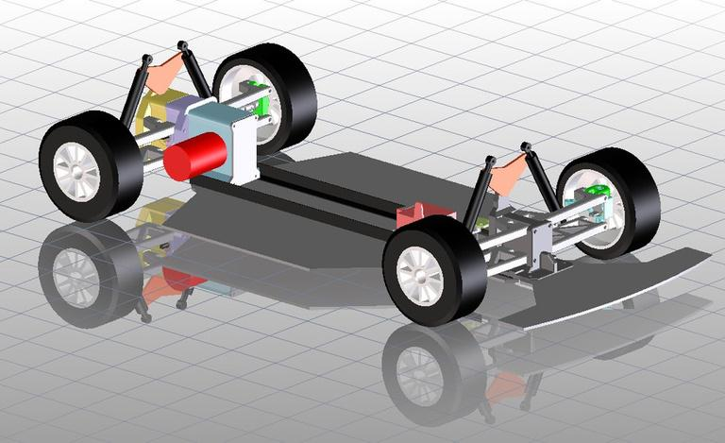
Using Onshape
Direction
Talk to Zegna! He has experience using cad and may recommend using something else instead
Try making different designs first just to familiarize yourself with the software, these do not have to be related to the RC car project
After you are familiar with Onshape, then move to designing the body of the car

Slide 7
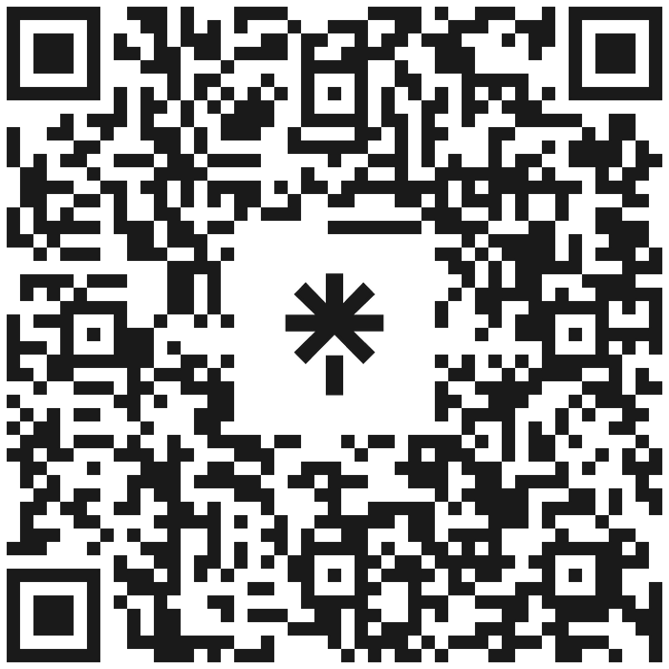



NEW LINKTREE
FOLLOW THE INSTAGRAM AND JOIN THE DISCORD FOR ANNOUNCEMENTS AND INFORMATION

